Slide 1
Sensitivity Analysis and Duality

Slide 2
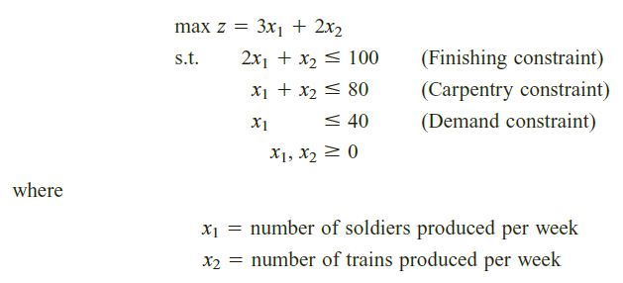
Graphical Introduction To Sensitivity Analysis
Sensitivity analysis is concerned with how changes in an LP’s parameters affect the LP’s optimal solution.
Reconsider the Giapetto problem;

Slide 3
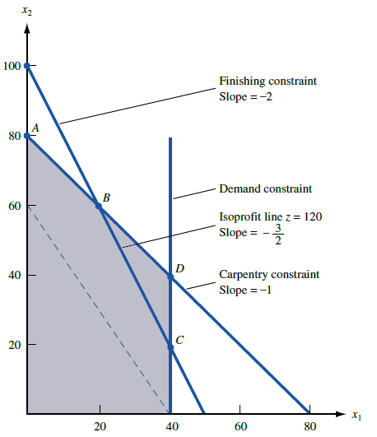
The optimal solution to this problem is
z= 180, x₁ =20, x₂ = 60 (point B in Figure ),
It has x₁, x₂, and s₃ (the slack variable for the demand constraint) as basic variables.
How would changes in the problem’s objective function coefficients or right-hand sides
change this optimal solution?

Slide 4
Graphical Analysis of the Effect of a Change in an Objective Function Coefficient
If the contribution to profit of a soldier were to increase sufficiently, then it would be optimal for Giapetto to produce more soldiers (s3 would become nonbasic).
Similarly, if the contribution to profit of a soldier were to decrease sufficiently, it would be optimal for Giapetto to produce only trains (x1 would now be nonbasic).
Let’s show how to determine the values of the contribution to profit for soldiers for which the current optimal basis will remain optimal.

Slide 5
Graphical Analysis of the Effect of a Change in a Right-Hand Side on the LP’s Optimal Solution
A graphical analysis can also be used to determine whether a change in the right-hand side of a constraint will make the current basis no longer optimal.
Let b1 be the number of available finishing hours. Currently b1= 100
For what values of b1 the current basis remain optimal?

Slide 6
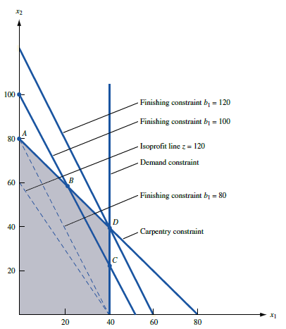

Slide 7
As long as the current basis remains optimal, it is a routine matter to determine how a change in the right-hand side of a constraint changes the values of the decision variables.
To illustrate the idea, let b1 number of available finishing hours.
If we change b1 to 100+∆ , we know that the current basis remains optimal for 20 ≤∆≤ 20.
The optimal solution to the LP is still the point where the finishing-hour and carpentry-hour constraints are binding.

Slide 10
In a constraint with positive slack (or positive excess) in an LP’s optimal solution, if we change RHS of the constraint to a value in the range where the current basis remain optimal, the optimal solution to the LP is unchanged.

Slide 11
Shadow Prices
The shadow price for the ith constraint of an LP to be the amount by which the optimal z-value is improved (improvement means increase in a max problem and decrease in a min problem) if the right-hand side of the ith constraint is increased by 1.
This definition applies only if the change in the right-hand side of Constraint i leaves the current basis optimal.

Slide 12
Some important formulas
In this section, we use our knowledge of matrices to show how an LP’s optimal tableau can be expressed in terms of the LP’s parameters.
The formulas developed in this section are used in our study of sensitivity analysis, duality, and advanced LP topics.
Assume that we are solving a max problem that has been prepared for solution by the Big M method and that at this point, the LP has m constraints and n variables.
Although some of these variables may be slack, excess, or artificial, we choose to label them;

Slide 13
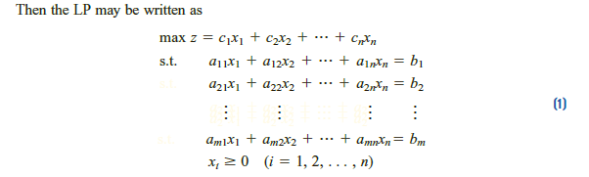
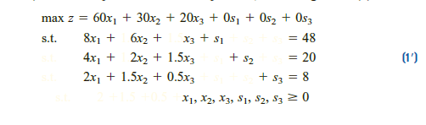
Dakota Furniture Problem

Slide 14
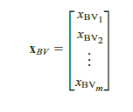
Let BVi be the basic variable for row i of the optimal tableau. Also define BV {BV1, BV2, . . . , BVm} to be the set of basic variables in the optimal tableau, and define the mX1 vector
We also define NBV the set of nonbasic variables in the optimal tableau
x_{NBV} (n- m)X 1 vector listing the nonbasic variables (in any desired order)

Slide 15
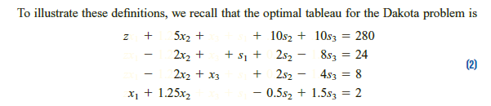






Slide 16


Expressing the Constraints in Any Tableau in Terms of B⁻¹ and the Original LP

Slide 17
Determining the Optimal Tableau’s Row 0 in Terms of the Initial LP
How to express row 0 of the optimal tableau in terms of BV and the original LP (1).
To begin, multiply the constraints (expressed in the form Bx_{BV} + Nx_{NBV} =b) through by the vector c_{BV}B⁻¹:
and Rewrite the original objective function,
By adding (7) to (8), we can eliminate the optimal tableau’s basic variables and obtain its row 0:

Slide 18
From (9), the coefficient of xj in row 0 is;
and the right-hand side of row 0 is c_{BV}B⁻¹b.

Slide 19


Simplifying Formula (10) for Slack, Excess, and Artificial Variables

Slide 20
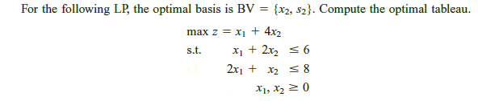
Example

Slide 21
Sensitivity Analysis
We now explore how changes in an LP’s parameters (objective function coefficients, righthand sides, and technological coefficients) change the optimal solution.
As described in the beginning, the study of how an LP’s optimal solution depends on its parameters is called sensitivity analysis.

Slide 22
BV be the set of basic variables in the optimal tableau. Given a change (or changes) in an LP, we want to determine whether BV remains optimal.
The mechanics of sensitivity analysis hinge on the following important observation.
From previous lectures, we know that a simplex tableau (for a max problem) for a set of basic variables BV is optimal if and only if each constraint has a nonnegative right-hand side and each variable has a nonnegative coefficient in row 0.
This follows, because if each constraint has a nonnegative right-hand side, then BV’s basic solution is feasible, and if each variable in row 0 has a nonnegative coefficient, then there can be no basic feasible solution with a higher z-value than BV.
Our observation implies that whether a tableau is feasible and optimal depends only on the right-hand sides of the constraints and on the coefficients of each variable in row 0

Slide 23
Suppose we have solved an LP and have found that BV is an optimal basis. We can use the following procedure to determine if any change in the LP will cause BV to be no longer optimal.
Step 1 Using the formulas of previous topic, determine how changes in the LP’s parameters change the right-hand side and row 0 of the optimal tableau (the tableau having BV as the set of basic variables).
Step 2 If each variable in row 0 has a non-negative coefficient and each constraint has a nonnegative right-hand side, then BV is still optimal. Otherwise, BV is no longer optimal.

Slide 24
If BV is no longer optimal, then you can find the new optimal solution by using the Previous section formulas to recreate the entire tableau for BV and then continuing the simplex algorithm with the BV tableau as your starting tableau.

Slide 25
There can be two reasons why a change in an LP’s parameters causes BV to be no longer optimal.
First, a variable (or variables) in row 0 may have a negative coefficient.
In this case, a better (larger z-value) bfs can be obtained by pivoting in a nonbasic variable with a negative coefficient in row 0.
If this occurs, we say that BV is now a suboptimal basis.
Second, a constraint (or constraints) may now have a negative right-hand side.
In this case, at least one member of BV will now be negative and BV will no longer yield a bfs. If this occurs, we say that BV is now an infeasible basis.

Slide 26
Again consider the Dakota Furniture Example;
We now discuss how six types of changes in an LP’s parameters change the optimal solution:
Change 1 Changing the objective function coefficient of a nonbasic variable
Change 2 Changing the objective function coefficient of a basic variable
Change 3 Changing the right-hand side of a constraint
Change 4 Changing the column of a nonbasic variable
Change 5 Adding a new variable or activity
Change 6 Adding a new constraint (not covered!!!)

Slide 27
Changing the Objective Function Coefficient of a Nonbasic Variable
In the Dakota problem, the only nonbasic decision variable is x₂ (tables).
Currently, the objective function coefficient of x₂ is c₂= 30. How would a change in c₂ affect the optimal solution to the Dakota problem? More specifically, for what values of c₂ would BV {s₁, x₃, x₁} remain optimal?
Suppose we change the objective function coefficient of x₂ from 30 to 30 +∆ .
Then ∆ represents the amount by which we have changed c₂ from its current value.
For what values of ∆ will the current set of basic variables (the current basis) remain optimal?

Slide 28
We begin by determining how changing c₂ from 30 to 30 + ∆ will change the BV tableau.
Note that B⁻¹ and b are unchanged, and therefore the right-hand side of BV’s tableau (B⁻¹b) has not changed, so BV is still feasible.
Because x₂ is a nonbasic variable, c_{BV} has not changed. From (10), we can see that the only variable whose row 0 coefficient will be changed by a change in c₂ is x₂. Thus, BV will remain optimal if ≥0, and BV will be suboptimal if ≤0.
In this case, z could be improved by entering x₂ into the basis.

Slide 29
If BV remains optimal after a change in a nonbasic variable’s objective function coefficient, the values of the decision variables and the optimal z-value remain unchanged.
This is because a change in the objective function coefficient for a nonbasic variable leaves the right-hand side of row 0 and the constraints unchanged. For example, if the price of tables increases to $33 (c2= 33), the optimal solution to the Dakota problem remains unchanged (Dakota should still make 2 desks and 8 chairs, and z = 280).
On the other hand, if c2> 35, BV will no longer be optimal, because . In this case, we find the new optimal solution by recreating the BV tableau and then using the simplex algorithm.

Slide 30
This analysis yields another interpretation of the reduced cost of a nonbasic variable: The reduced cost for a nonbasic variable (in a max problem) is the maximum amount by which the variable’s objective function coefficient can be increased before the current basis becomes suboptimal, and it becomes optimal for the nonbasic variable to enter the basis.

Slide 31
Changing the Objective Function Coefficient of a Basic Variable
In the Dakota problem, the decision variables x1 (desks) and x3 (chairs) are basic variables. We now explain how a change in the objective function coefficient of a basic variable will affect an LP’s optimal solution. We begin by analyzing how this change affects the BV tableau.
Because we are not changing B (or therefore B⁻¹) or b, (6) shows that the right-hand side of each constraint will remain unchanged, and BV will remain feasible.
Because we are changing c_{BV}, however, so c_{BV}B⁻¹ will change.
From (10), we see that a change in c_{BV}B⁻¹ may change more
than one coefficient in row 0.
To determine whether BV remains optimal, we must use (10) to recompute row 0 for the BV tableau.
If each variable in row 0 still has a nonnegative coefficient, BV remains optimal. Otherwise, BV is now suboptimal.

Slide 32
In the Dakota problem, the decision variables x1 (desks) and x3 (chairs) are basic variables.
A change in objective function coefficient of x1 variable.

Slide 33
Changing the Right-Hand Side of a Constraint
Changing the right hand side of a constraint will leave row 0 of the optimal tableau unchanged;
Changing a right-hand side cannot cause the current basis to become suboptimal.
A change in the right-hand side of a constraint will affect the right hand side of the constraints in the optimal tableau.
As long as the right-hand side of each constraint in the optimal tableau remains nonnegative, the current basis remains feasible and optimal. If at least one right-hand side in the optimal tableau becomes negative, then the current basis is no longer feasible and therefore no longer optimal.

Slide 34
Suppose we want to determine how changing the amount of finishing hours (b2) affects the optimal solution to the Dakota problem.

Slide 35
Adding a New Activity
In many situations, opportunities arise to undertake new activities.
For example, in the Dakota problem, the company may be presented with the opportunity to manufacture additional types of furniture, such as footstools.
If a new activity is available, we can evaluate it by applying the method utilized to determine whether the current basis remains optimal after a change in the column of a nonbasic variable.

Slide 36
Suppose that Dakota is considering making footstools. A stool sells for $15 and requires 1 board foot of lumber, 1 finishing hour, and 1 carpentry hour. Should the company manufacture any stools?

Slide 37
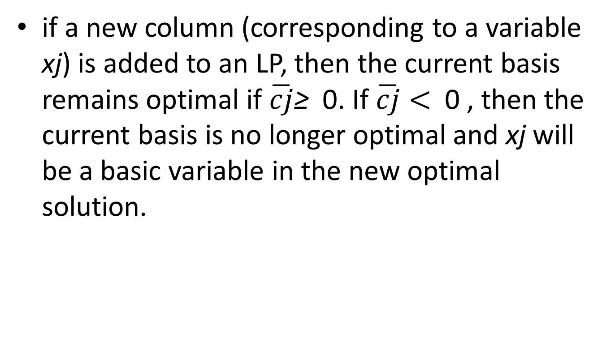
if a new column (corresponding to a variable xj) is added to an LP, then the current basis remains optimal if $\overline{cj}$≥ 0. If $\overline{cj}<$ 0 , then the current basis is no longer optimal and xj will be a basic variable in the new optimal solution.

Slide 38
Changing the Column of a Nonbasic Variable
Currently, 6 board feet of lumber, 2 finishing hours, and 1.5 carpentry hours are required to make a table that can be sold for $30.
x2 (the variable for tables) is a nonbasic variable in the optimal solution. This means that Dakota should not manufacture any tables now.
Suppose, however, that the price of tables increased to $43 and, because of changes in production technology, a table required 5 board feet of lumber, 2 finishing hours, and 2 carpentry hours. Would this change the optimal solution to the Dakota problem?

Slide 39
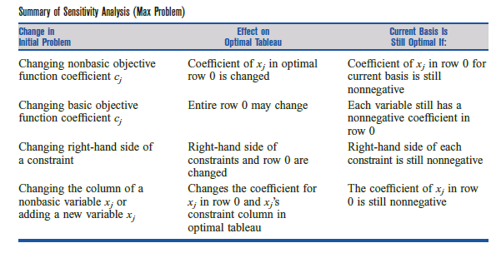

Slide 40

Example;
İf BV={x3,x2} and NBV={x1,s1,s2}
Compute the optimal Tableau
For what values of x1 objective function coefficient does the current basis remain optimal?
If the objective function coefficient for x1 were 7, what would be the new optimal solution to Sugarco’s problem?

Slide 41
For what values of x2 objective function coefficient would the current basis remain optimal?
If the objective function coefficient for x3 is 13, then what would be the new optimal solution to Sugarco’s problem?
For what amount of available sugar would the current basis remain optimal?
If 60 oz of sugar were available, what would be objective function value?
Could these questions be answered if only 30 oz of sugar were available?

Slide 42
Suppose x1 constraint coefficients are; 0.5,0.5(instead of 1 and 2). Is x1 a BV?
x4 is considered to be added. The objective function coefficient of x4 is 17 and coefficients for constraints is 3 and 4.
Is x4 a candidate for becoming a BV?

